Slide 1
Hashing
Topic 2.3

Slide 2
Hashing Techniques:
Hashing:
Hashing is a technique used to Performing Insertion, deletion & search operations in the constant average time by implementing Hash table Data Structure .
It is used to Index and Retrieve Items in a Database.

Slide 3
Two Types of Hashing
Static Hashing .
Dynamic Hashing .
Static Hashing :
It is the hash function maps search key value to a fixed set of locations.
Dynamic Hashing :
The Hash Table can grow to handle more Items.The associated Hash Function must Change as the table grows.

Slide 4
Hash Table :
The Hash Table data structure is a array of some fixed size table containing the Keys.
A Key is a values associated with each record.
A Hash table is partition into array of size.
Each Bucket has many slots and each slots holds one records.
Hash Function :
A Hashing Function is a key to address Transformation which acts upon a given Key to complete the Relative Position of the Key in a
array
4

Slide 5
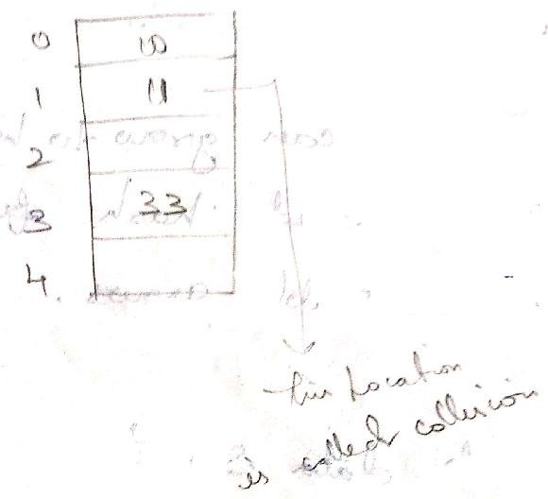
A Key can be a member of a String etc..
A Hash Function Formula is
Hash (Key Value ) =(Key Values % Table Size)
Hash (Key Value)=Key Values % Table Size
Hash(10) =10 % 5=0
Hash(33) =33 % 5 =3
Hash(11)=11 % 5=1
Hash(21)= 21 % 5=1

Slide 6
A Good Hashing consist of
Minimum Collision.
Be easy and quick to complete.
Distribute Key Value Every in the Hash Table.
Use all the Information Provided in the Key.
Application of Hash Table:
Database Systems
Symbol Tables .
Data Dictionaries
Network Processing Algorithm
Browse Casher.

Slide 7
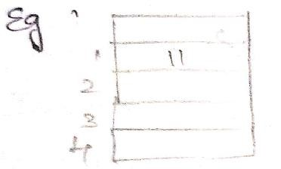
Collision :
Collision occurs when a hash values of a records being Inserted hashes to an Address That already contains a difference Record.
“ When Two Key values hash to the position”.
Insert 11,21 in hash table 11 =Hash(11) =11%5 =1
21= Hash (21) =21%5 =1
(collision occur)

Slide 8
Collision Resolution :
The Process of finding another Position for The Collide Record Is said to be collision Resolution Strategy.
Two categories of Hashing .
Open Hashing
eg: Separate Chaining.
Closed Hashing .
eg : Open Addressing ,Rehashing and Extendable hashing.

Slide 9
Open Hashing :
Each Bucket in the Hash table is the head of a Linked List.
All Elements that hash to a Particular Bucket are Placed on the Buckets Linked List .
Closed Hashing:
Ensures that all elements are stored directly in to the Hash Table.

Slide 10
Separate Chaining :
Separate Chaining is an open hashing Technique
A Pointer fields is added to each record Location.
In this method the table can never overflow since the linked are only extended upon or New Keys.
Example:
10 , 11 , 81 , 10 , 7 , 34 , 94 , 17 , 29 , 89 , 99

Slide 11
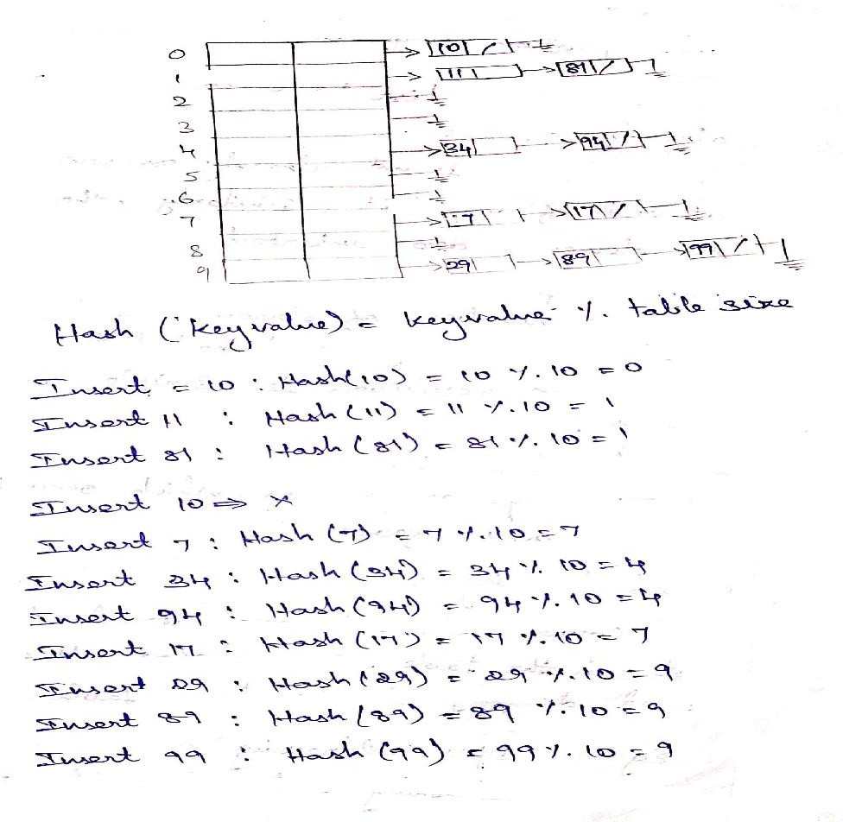

Slide 12
The element 81 collides to the same of the hash value to place the value 81 at this position perform the following.
Traverse the list to check whether it is already present.
Since, it is not already present, insert at end of the list similarly, the rest of the elements are inserted.
Advantages:
More number of elements can be inserted as it uses of linked list.
Collision resolution is simple and efficient.

Slide 13
Disadvantages:
It requires pointers, which occupies more memory space.
Closed hashing:
Collide elements are stored at another slot in the table. Ensures that all elements stored directly in the hash table.
Eg: Open addressing
Rehashing and extendable hashing.

Slide 14
Open Addressing:
Open addressing also called closed hashing which is an attentive to resolve the collision with linked list.
If a collision occurs, alternative cells are tried until an empty cell is found (i.e) cells ho(x), h1(x), h2(x) are tried in succession.
There are three common collision strategies, there are
•
Linear Probing
Quadratic Probing
Double Hashing

Slide 15
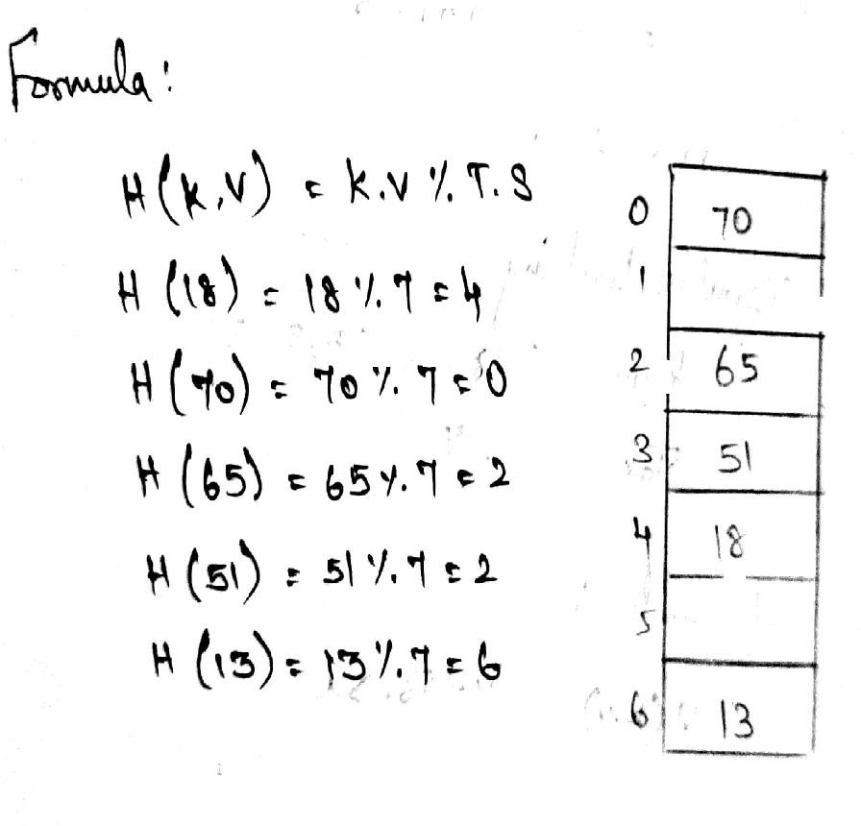
1.Linear Probing:
Key value :18,70,65,51,13 Table size : 7

Slide 16
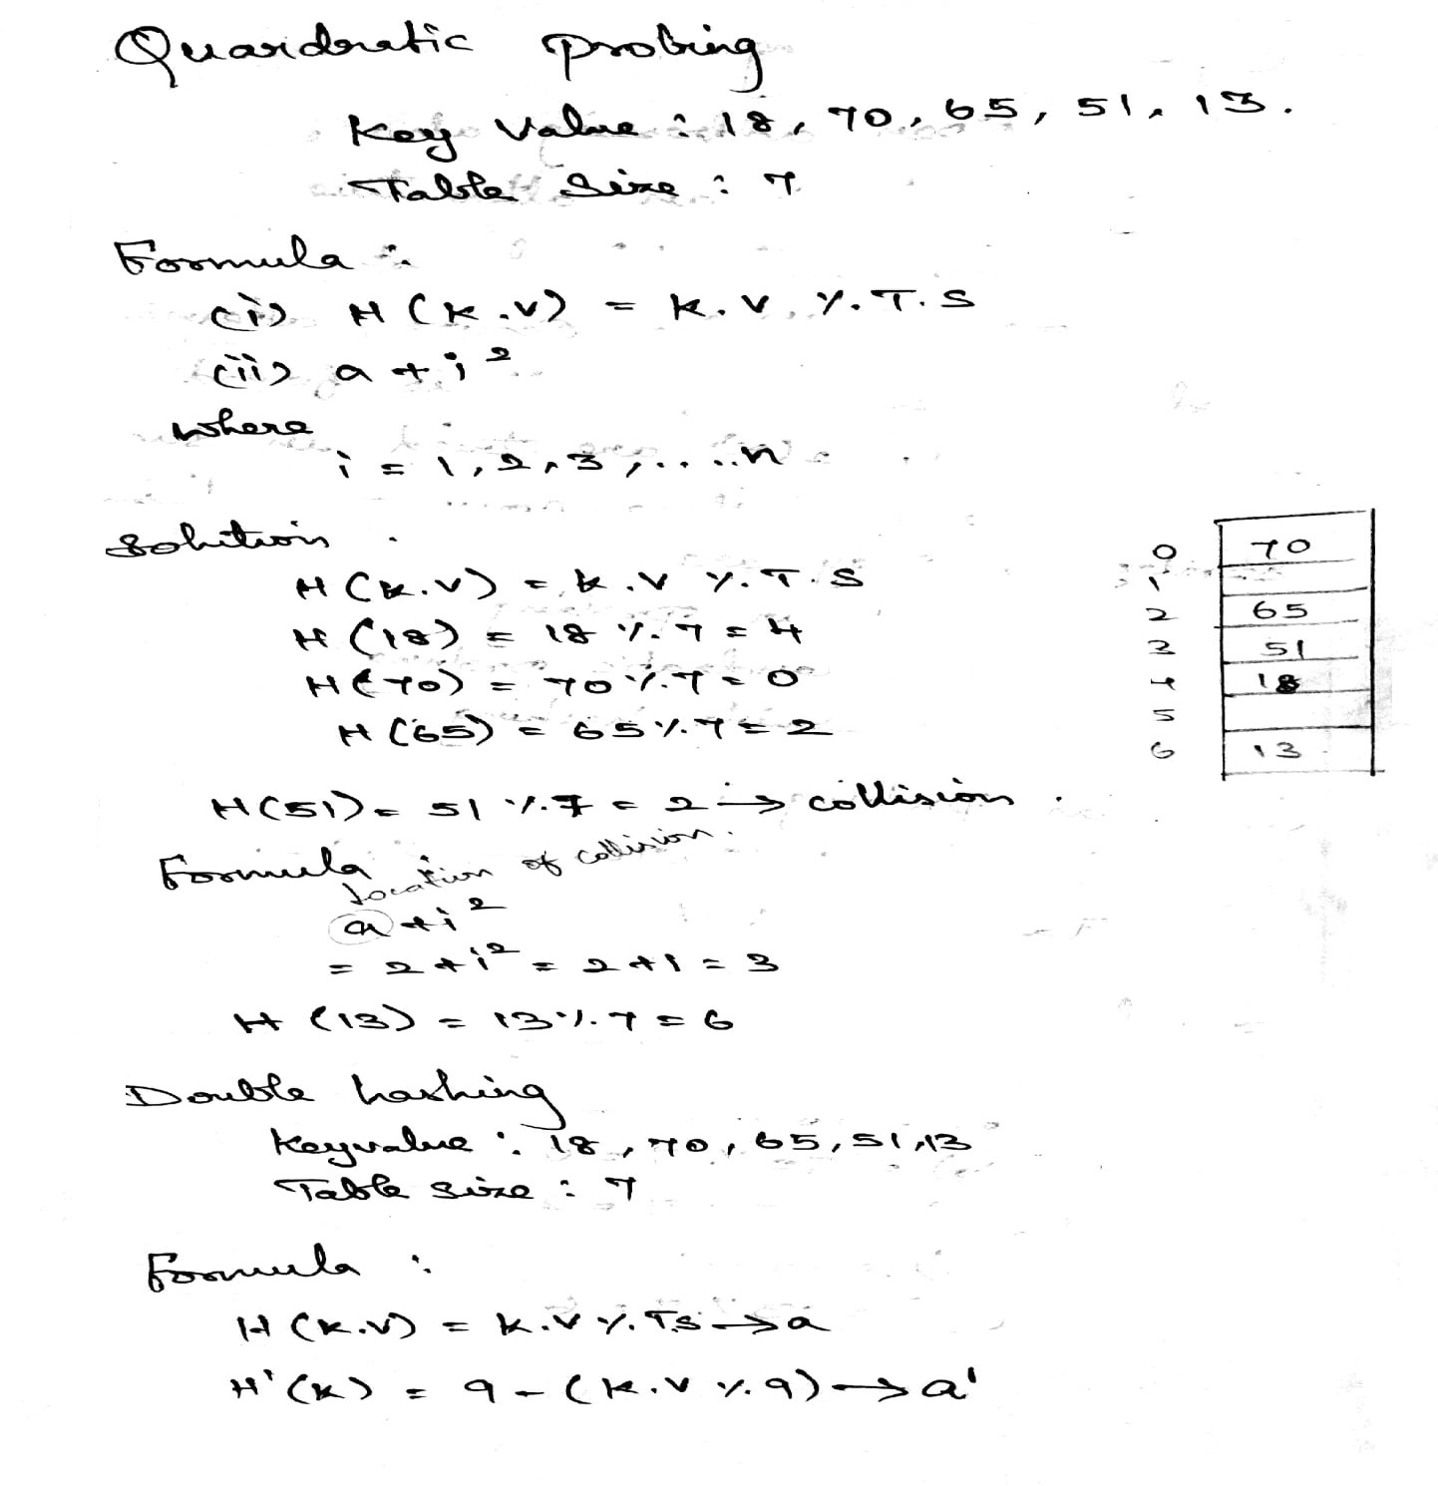

Slide 17
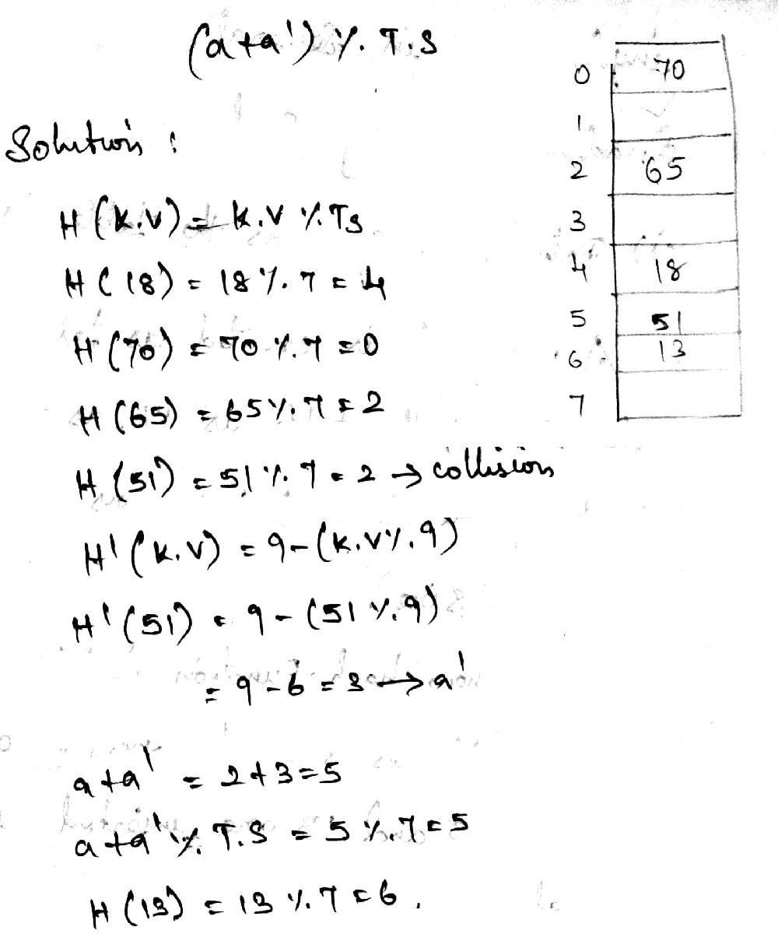

Slide 18
Rehashing:
If the table get’s to full. Then the rehashing method new tables that is about twice as with and scan down the entire original hash table.
The entire original hash table, computing the new hash value for each element and in sorting it in the new table.
•
Rehashing is very expensive operations, the running time is O(N), Rehashing can be implements is several ways with Quadratic probing such as
i). Rehash as soon as the table is half full.

Slide 19
A new table is created as table so full. The size of the table so full. The size of the table is 17, as this to the first prime (i.e) a) twice as large as the old table size.
The new hash function is h(x) = Xmod 17 the old table is scanned and the elements, 6,15,24,23 and 13 are inserted into the new table.

Slide 20
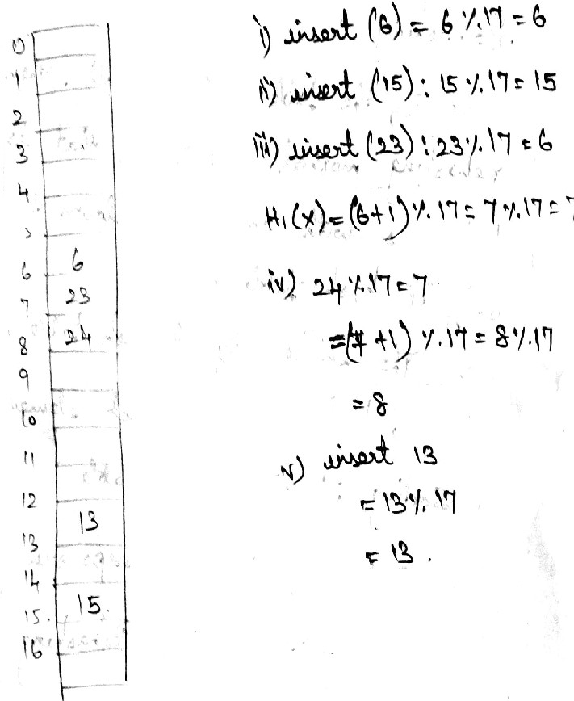

Slide 21
Advantages:
Programmer does not about the table size.
Simple to implement.
It can be used in order data structure as well.
ii) Rehash only when an insertion fails. Suppose the elements 13,15 ,23 ,24 & 6 are insert into an open addressing hash table of size.
Hash function h(x) = x mod 7

Slide 22
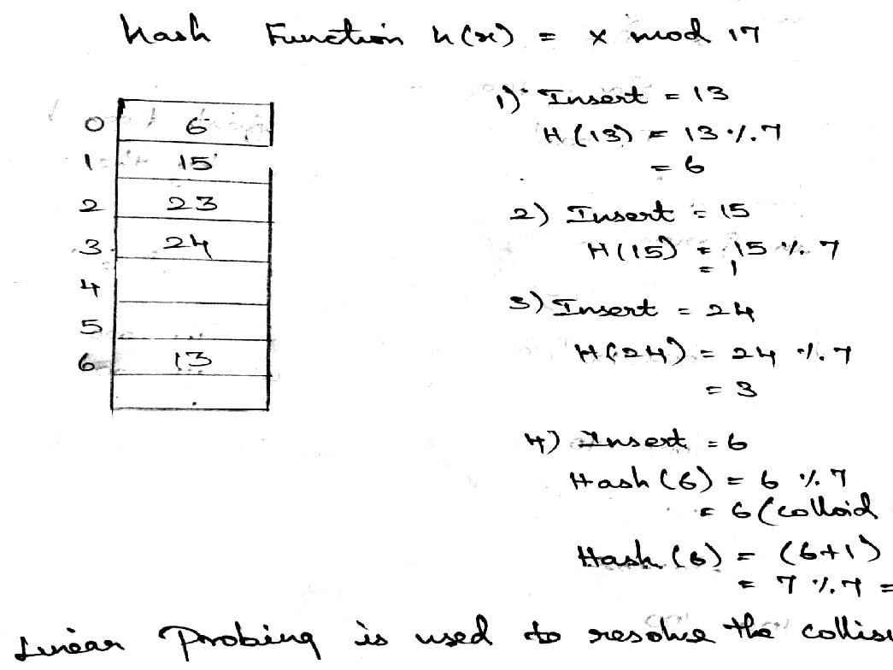

Slide 23
If 23 is inserted into the Table ,the Resulting Table Will be over 70% Full.
Insert 23:
Hash(23)=23%7
=2
Extendable Hashing:
Extendable Hashing Allows a find to be Performed in two disk accesses. Insertion Also Requires few Disk accesses.
Let us support consider our data consist of determined by the leading two bits are the
data .
11

Slide 24
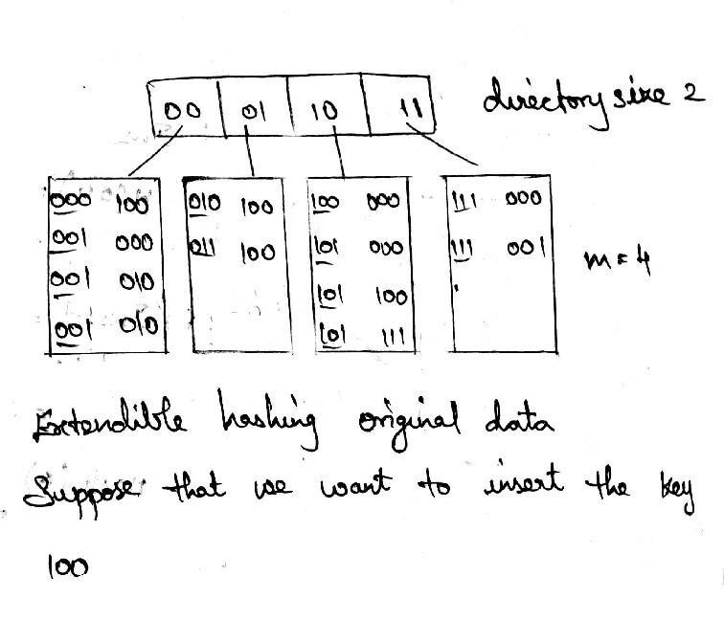
In each leaf has upto m=4 elements ,identified This is indicated by the number in Parenthesis.

Slide 25
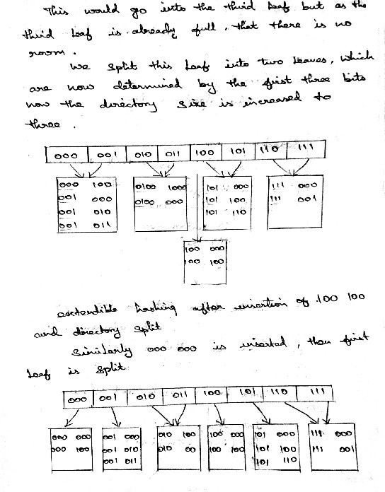

Slide 26
Advantages:
Provides quick access times for insert an find operation on large database.
Disadvantages:
This algorithm does not work if there are more then m duplicates.

